Slide 1
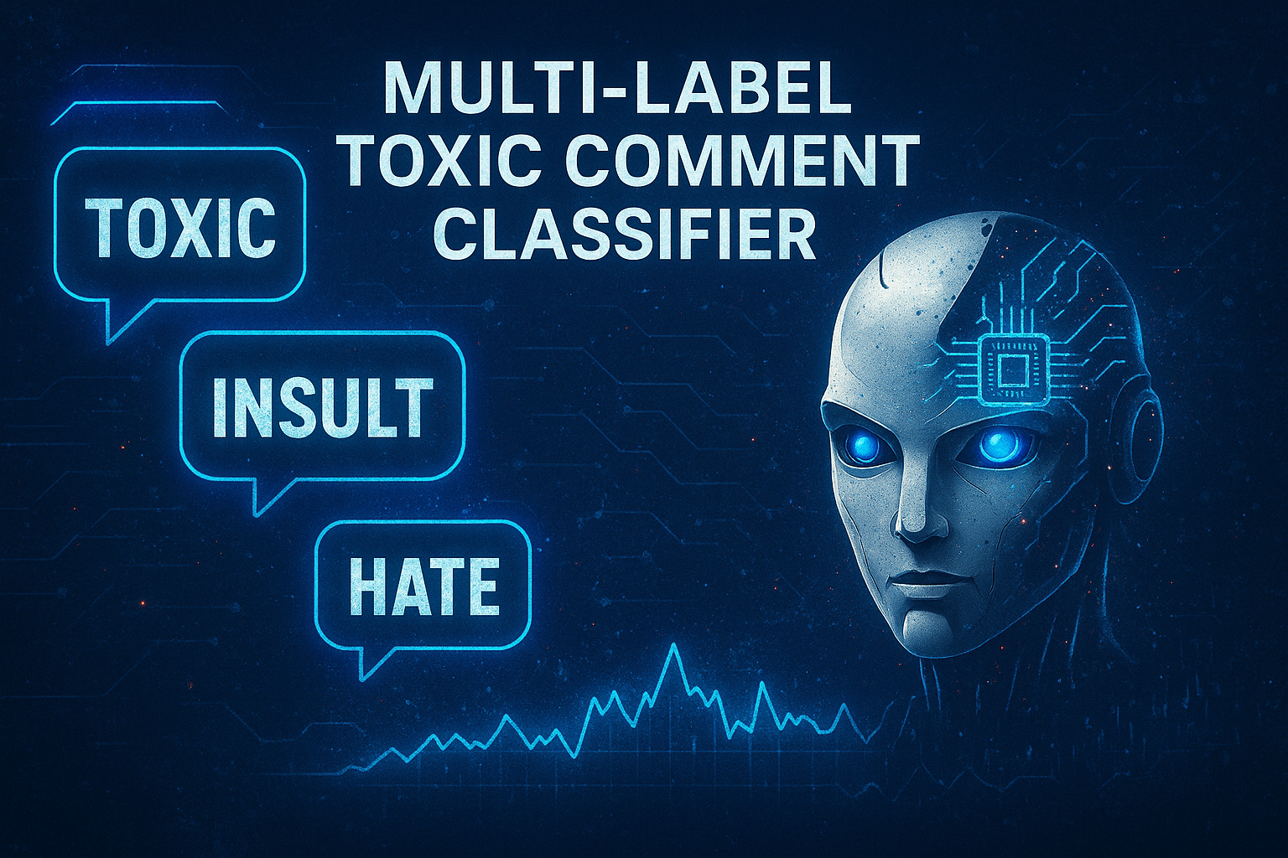

Comment Toxicity Detection
Mini Project-4
by Kavya P P
DS-C-WD-E-B39

Slide 2

Introduction
With the rise of user-generated content, online platforms face a surge in toxic and abusive comments. Manual moderation is inefficient at scale. This project proposes an automated system using NLP and an LSTM-based deep learning model to detect multiple types of toxicity, such as hate speech and threats, within a single comment. A Streamlit web app enables real-time and batch predictions, offering a practical solution for safer online communication.

Slide 3
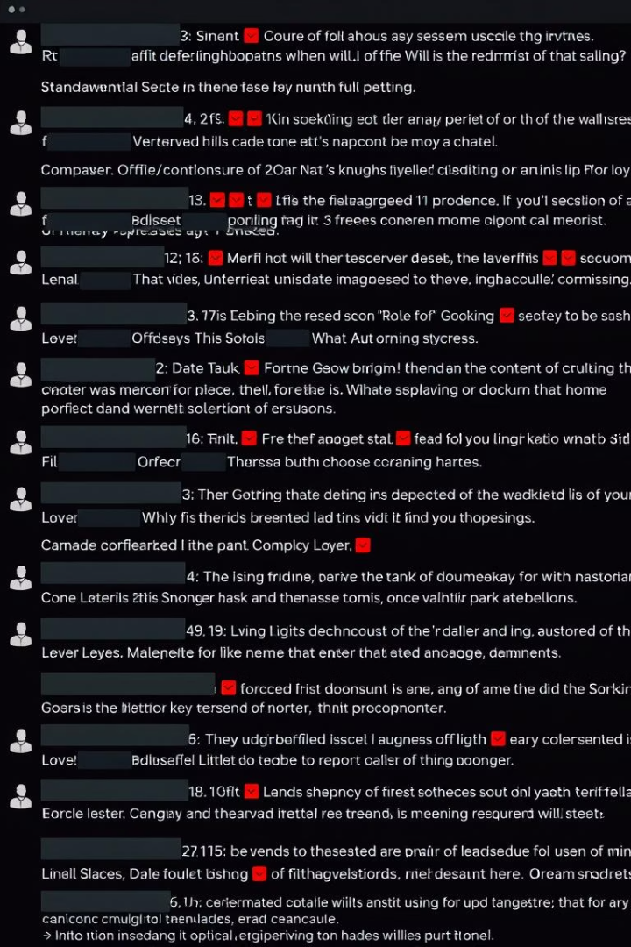
Problem Statement
Context
Online platforms face a surge of abusive comments harming users and discussions.
Goal
Build an automated system detecting multiple toxicity types within user comments.

Slide 4
Project Objectives
Multi-label Detection
Versatile Predictions
Identify several toxic behaviors in a single comment simultaneously.
Enable both real-time and batch CSV-based predictions.
User Interaction
Deep Learning Approach
Provide visual interactive results and CSV export options.
Use LSTM to enhance accuracy and generalization.

Slide 5

Dataset Overview
Source
Jigsaw Toxic Comment Classification Challenge
Total Records
159,571
Labels
toxic, severe_toxic, obscene, threat, insult, identity_hate
Multi-label
Multiple labels per comment allowed

Slide 6
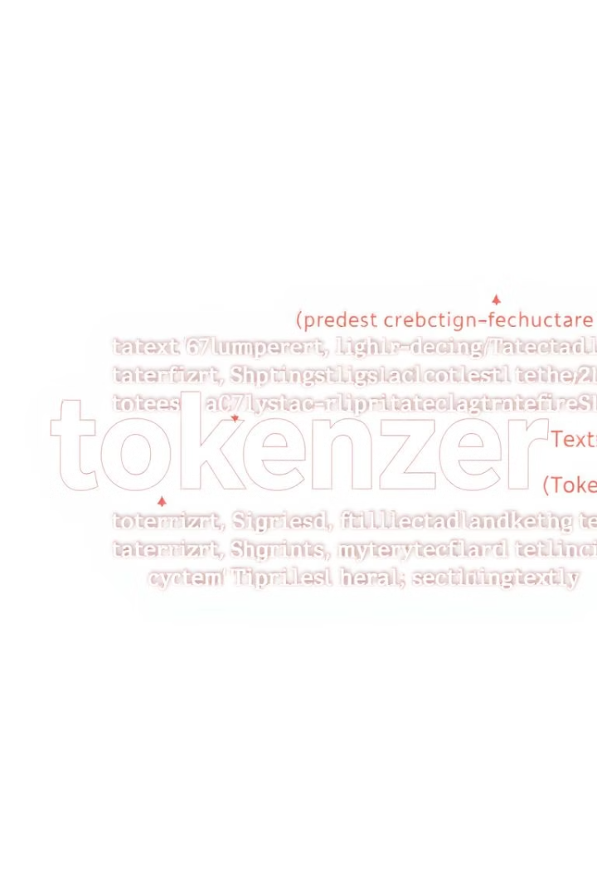
Preprocessing Details
Tokenizer Settings
Sequence Preparation
Vocabulary size set to 10,000; max length 150 tokens.
Text converted to padded sequences fitting model input requirements.
Label Matrix
Extracted multi-label matrix
for all six toxicity labels.

Slide 7
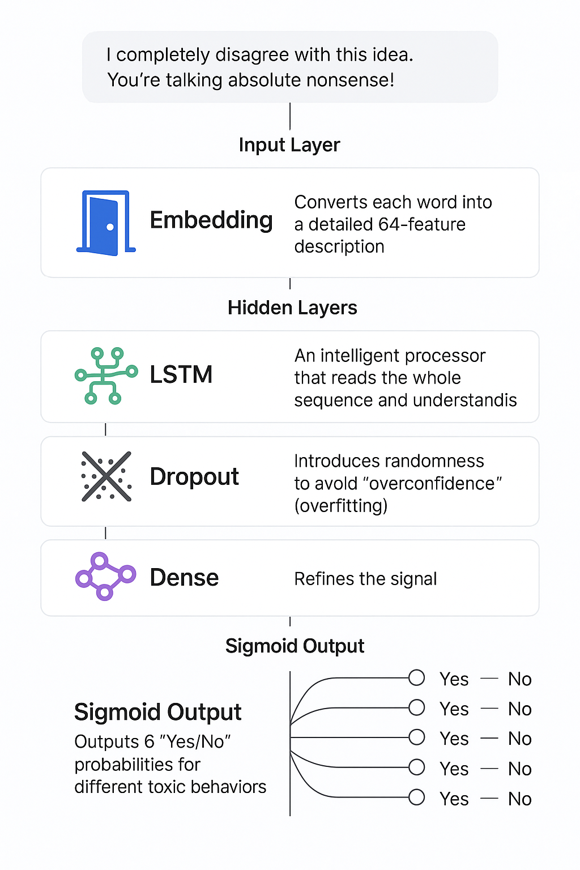
Model Architecture
Input Layer: Entry door that accepts 150-word long reviews. Embedding: Converts each word into a detailed 64-feature description.
LSTM: An intelligent processor that reads the whole sequence and understands context.
Dropout: Introduces randomness to avoid "overconfidence" (overfitting).
Dense Layer: Refines the signal.
Sigmoid Output: Outputs 6 "Yes/No" probabilities for different toxic behaviors.

Slide 8
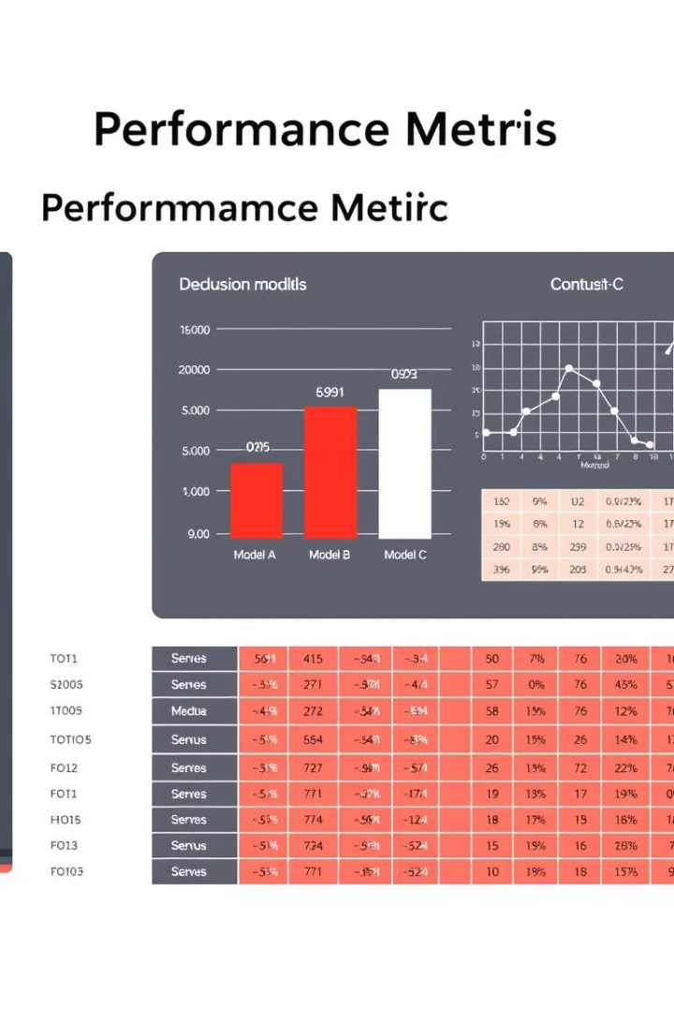
Model Evaluation Metrics
Overall Accuracy
F1 Scores
99%+ accuracy demonstrating excellent performance.
Toxic: 0.78
Obscene: 0.77
Insult: 0.67
Lower for rare classes due to imbalance
Evaluation Tools
Used classification report and multilabel confusion matrix.

Slide 9
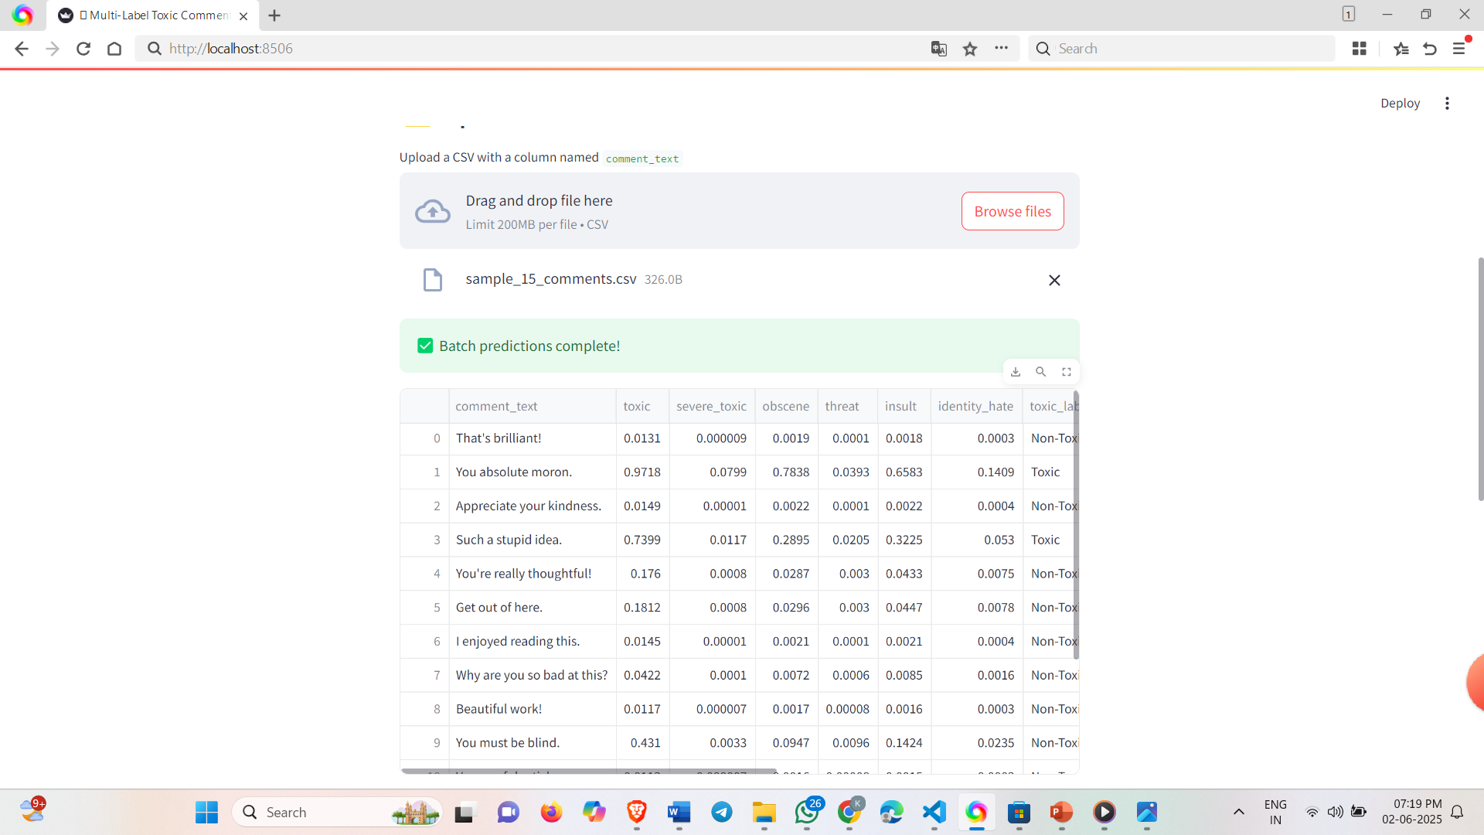
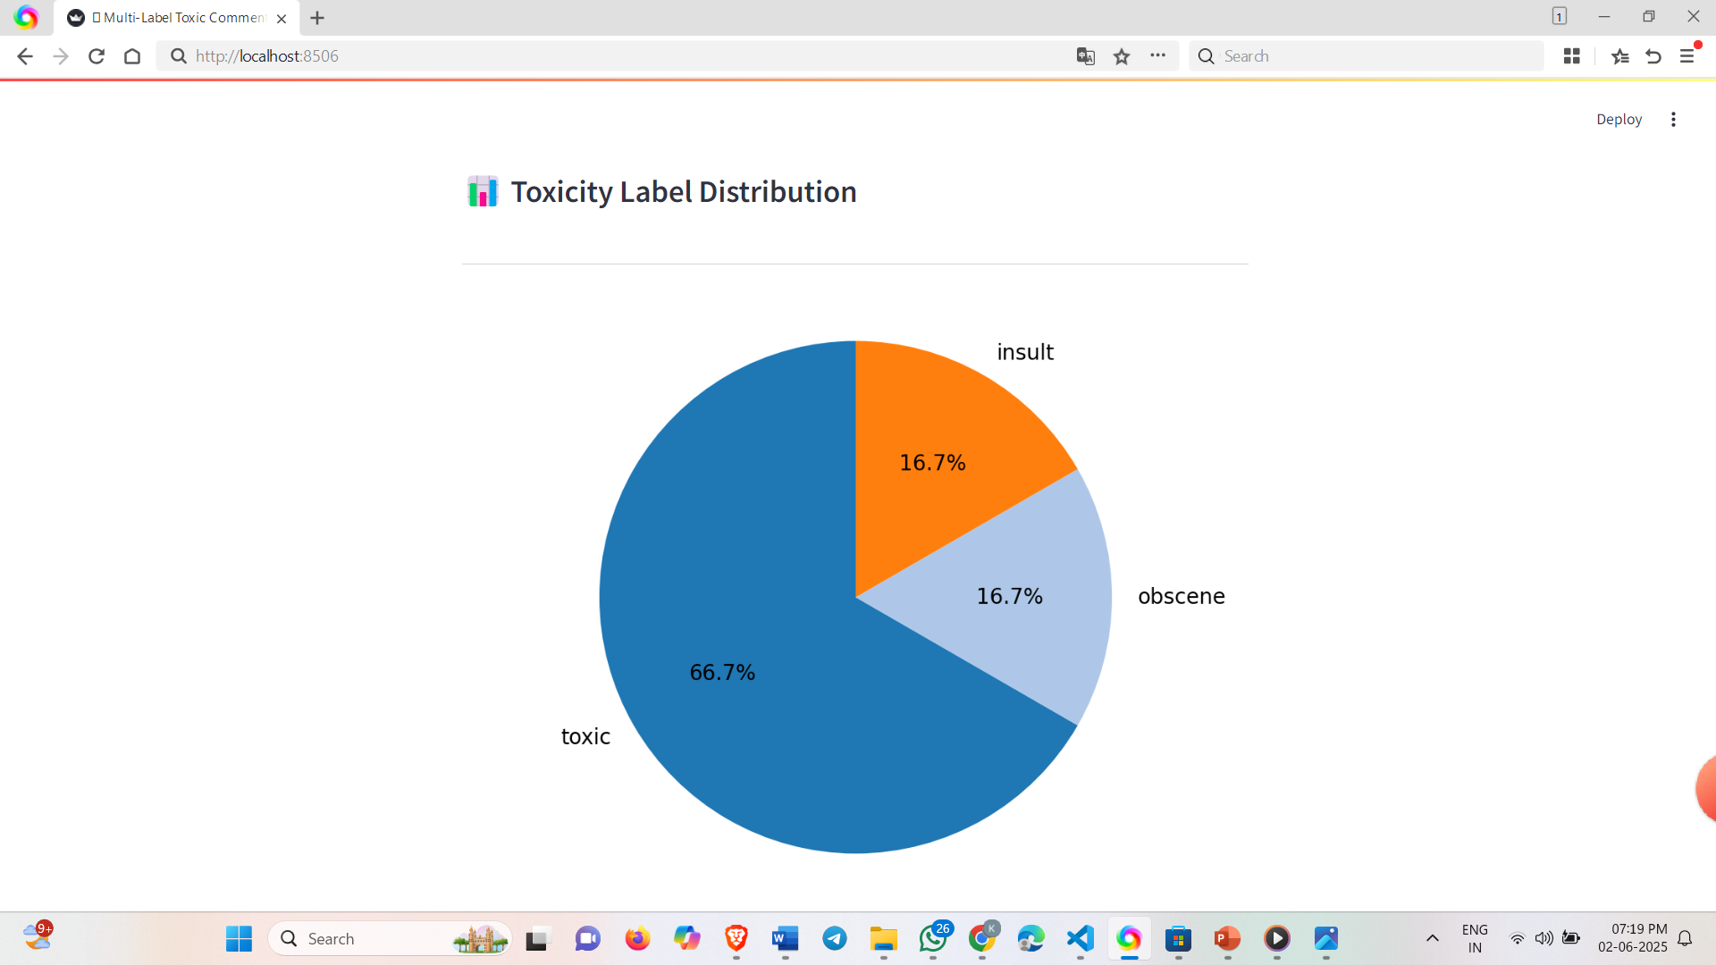
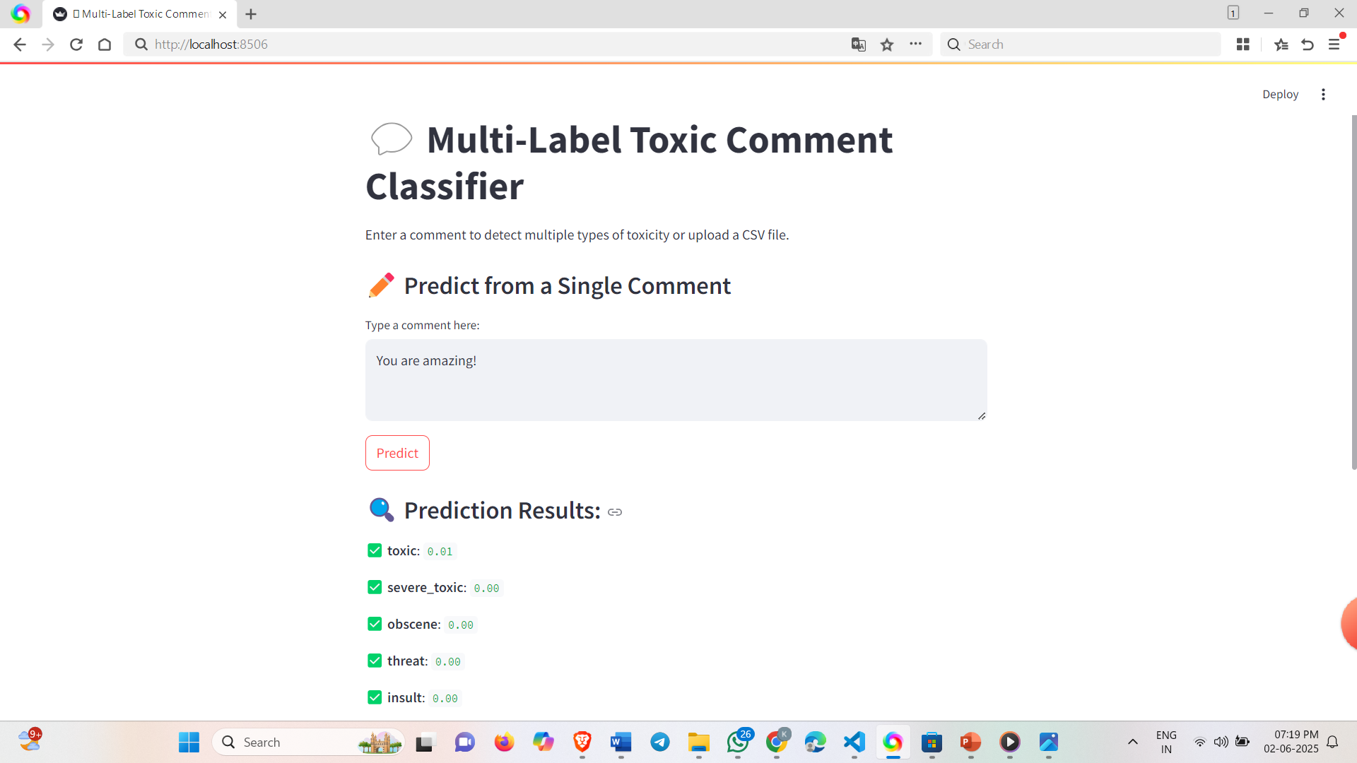
Demo Preview
Real-Time Prediction
Batch CSV Results
Label-Wise Distribution

Slide 10





Conclusion
Multi-label Classification Model
LSTM Implementation
User-friendly Application
Implemented using an LSTM deep learning network with high validation accuracy.
Developed a user-friendly Streamlit web app to handle real-time and batch predictions.
We successfully built a multi-label text classification model to detect toxic comments across 6 categories.
Visualization Tools
Community Impact
Visualized results with clear indicators and pie chart summaries.
This solution can support content moderation and help create healthier online communities.

Slide 11
Thankyou ☺

